Slide 1

Chapter 4
Mathematics of Cryptography
Part II: Algebraic Structures
4.<number>
Copyright © The McGraw-Hill Companies, Inc. Permission required for reproduction or display.

Slide 2
4-1 ALGEBRAIC STRUCTURES
Cryptography requires sets of integers and specific operations that are defined for those sets. The combination of the set and the operations that are applied to the elements of the set is called an algebraic structure. In this chapter, we will define three common algebraic structures: groups, rings, and fields.
Topics discussed in this section:
4.1.1 Groups
4.1.2 Rings
4.1.3 Fields
4.<number>

Slide 3
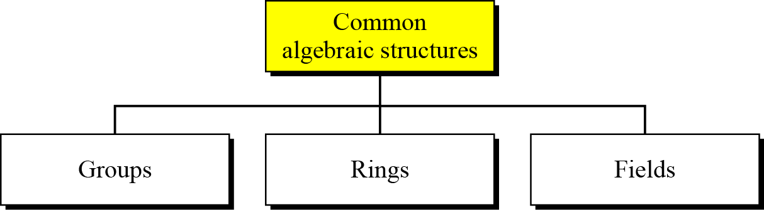
4.1 Continued
Figure 4.1 Common algebraic structure
4.<number>

Slide 4
4.1.1 Groups
A group (G) is a set of elements with a binary operation (•) that satisfies four properties (or axioms). A commutative group satisfies an extra property, commutativity:
❏ Closure:
❏ Associativity:
❏ Commutativity:
❏ Existence of identity:
❏ Existence of inverse:
4.<number>

Slide 5
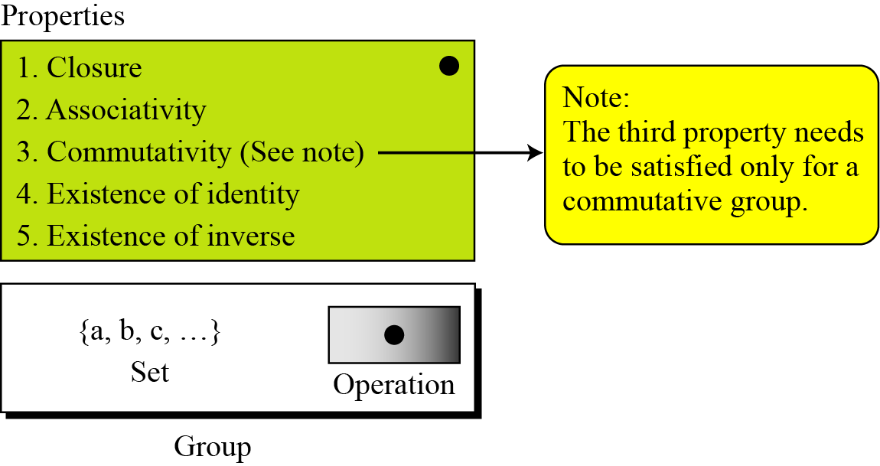
4.1.1 Continued
Figure 4.2 Group
4.<number>

Slide 6
4.1.1 Continued
Application
Although a group involves a single operation, the properties imposed on the operation allow the use of a pair of operations as long as they are inverses of each other.
Example 4.1
The set of residue integers with the addition operator,
G = < Z_{n} , +>,
is a commutative group. We can perform addition and subtraction on the elements of this set without moving out of the set.
4.<number>

Slide 7
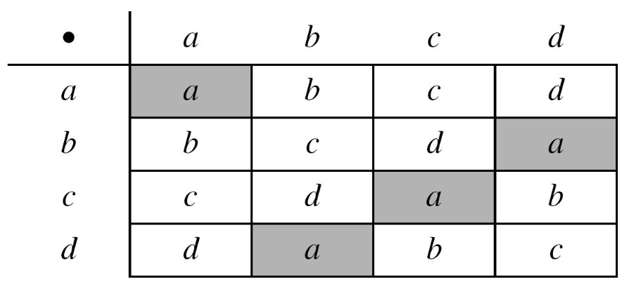
4.1.1 Continued
Example 4.2
The set Zn* with the multiplication operator, G = <Zn*, ×>, is also an abelian group.
Example 4.3
Let us define a set G = < {a, b, c, d}, •> and the operation as shown in Table 4.1.
4.<number>

Slide 8
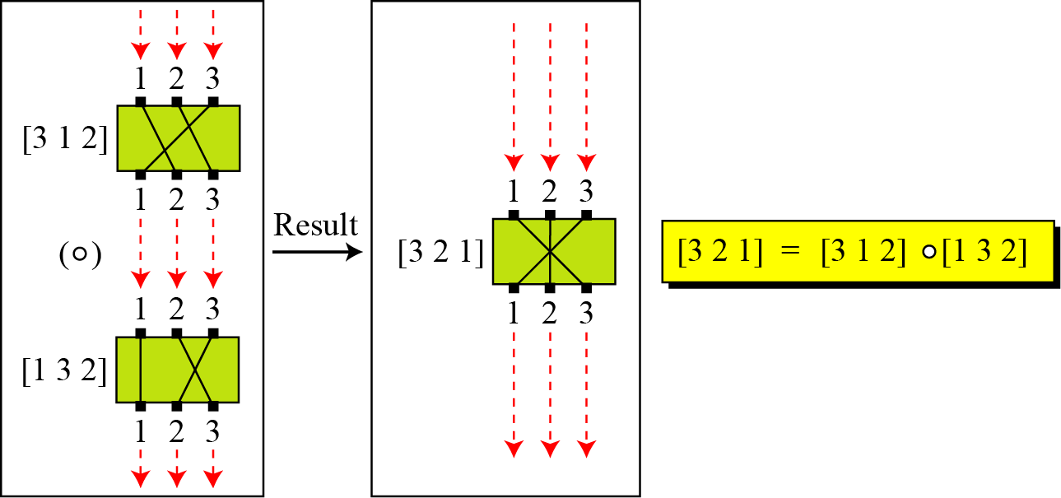
4.1.1 Continued
Example 4.4
A very interesting group is the permutation group. The set is the set of all permutations, and the operation is composition: applying one permutation after another.
Figure 4.3 Composition of permutation (Exercise 4.4)
4.<number>

Slide 9
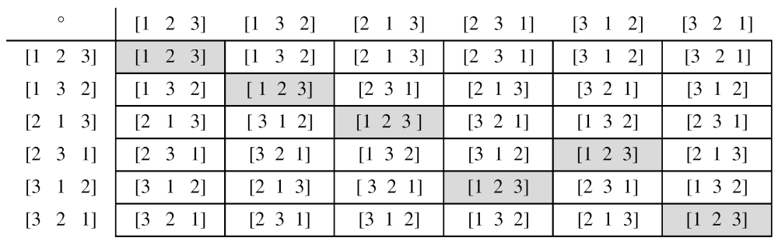
4.1.1 Continued
Example 4.4
Continued
Table 4.2 Operation table for permutation group
4.<number>

Slide 10
4.1.1 Continued
Example 4.5
In the previous example, we showed that a set of permutations with the composition operation is a group. This implies that using two permutations one after another cannot strengthen the security
of a cipher, because we can always find a permutation that can do the same job because of the closure property.
4.<number>

Slide 11
4.1.1 Continued
Finite Group
Order of a Group
Subgroups
4.<number>

Slide 12
4.1.1 Continued
Example 4.6
Is the group H = <Z₁₀, +> a subgroup of the group G = <Z12, +>?
Solution
The answer is no. Although H is a subset of G, the operations defined for these two groups are different. The operation in H is addition modulo 10; the operation in G is addition modulo 12.
4.<number>

Slide 13
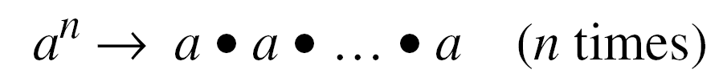
4.1.1 Continued
Cyclic Subgroups
If a subgroup of a group can be generated using the power of an element, the subgroup is called the cyclic subgroup.
4.<number>

Slide 14
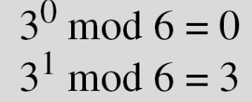

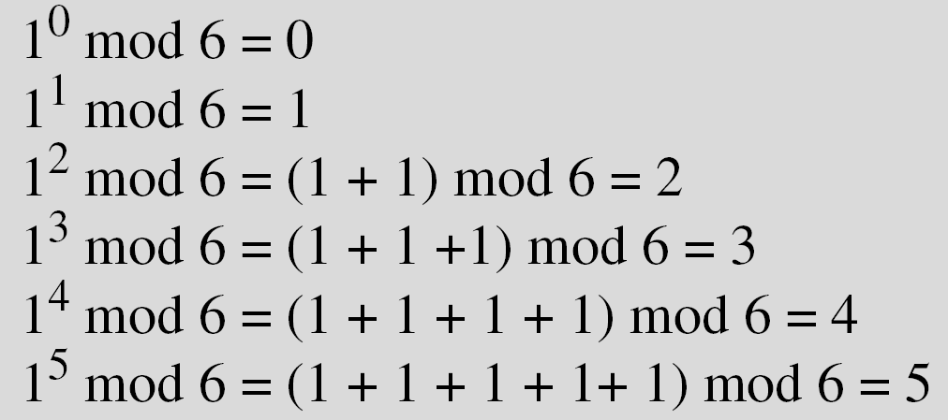
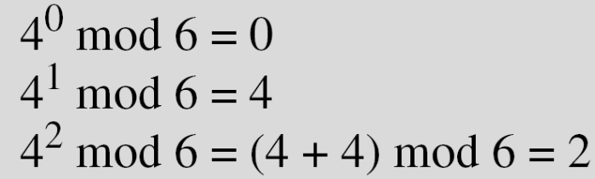
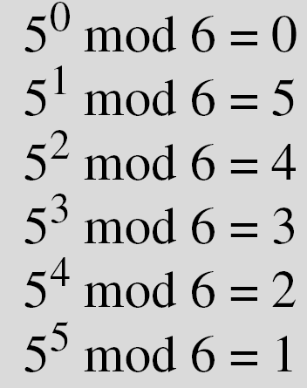
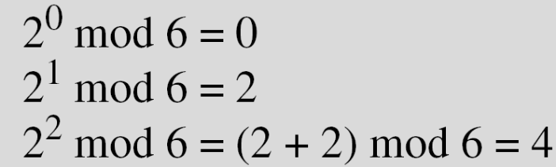
4.1.1 Continued
Example 4.7
Four cyclic subgroups can be made from the group G = <Z6, +>. They are H1 = <{0}, +>, H2 = <{0, 2, 4}, +>, H₃ = <{0, 3}, +>, and H4 = G.
4.<number>

Slide 15
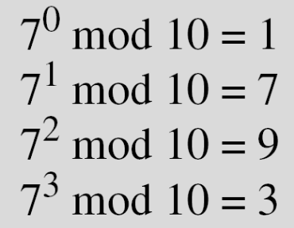

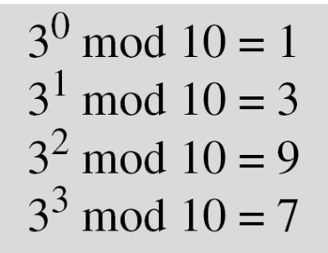
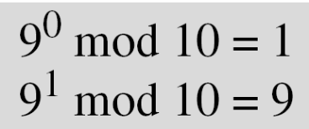
4.1.1 Continued
Example 4.8
Three cyclic subgroups can be made from the group
G = <Z10∗, ×>. G has only four elements: 1, 3, 7, and 9. The cyclic subgroups are H1 = <{1}, ×>, H2 = <{1, 9}, ×>, and H3 = G.
4.<number>

Slide 16
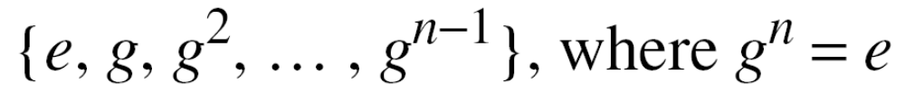
4.1.1 Continued
Cyclic Groups
A cyclic group is a group that is its own cyclic subgroup.
4.<number>

Slide 17
4.1.1 Continued
Example 4.9
Three cyclic subgroups can be made from the group
G = <Z10∗, ×>. G has only four elements: 1, 3, 7, and 9. The cyclic subgroups are H1 = <{1}, ×>, H2 = <{1, 9}, ×>, and H3 = G.
a. The group G = <Z6, +> is a cyclic group with two generators,
g = 1 and g = 5.
b. The group G = <Z10∗, ×> is a cyclic group with two generators,
g = 3 and g = 7.
4.<number>

Slide 18
4.1.1 Continued
Order of an Element
The order of an element is the order of the cyclic group it generates.
4.<number>

Slide 19
4.1.1 Continued
Example 4.10
a. In the group G = <Z₆, +>, the orders of the elements are:
ord(0) = 1, ord(1) = 6, ord(2) = 3, ord(3) = 2, ord(4) = 3,
ord(5) = 6.
b. In the group G = <Z₁₀*, ×>, the orders of the elements are:
ord(1) = 1, ord(3) = 4, ord(7) = 4, ord(9) = 2.
4.<number>

